Slide 1

INT-200 Internship Quarter 4 (I Year) SECOND REVIEW
Project Type: Data Analysis
Project Title: World Happiness Report
Presented By: Kali Deepak

Slide 2
PLAN OF THE TALK
Introduction (Background Research)
Introduction For Tableau
Introduction For MySQL
About Dataset
Formed Question For Analysis
Timeline
References

Slide 3

INTRODUCTION
Over time, happiness has been reducing around us, due to various factors mainly being stress. We wanted to know about the world situation regarding the same and hence we decided to work with this dataset.

Slide 4
OBJECTIVES
Learning all the basic concepts required for Data Analysis
Understanding the Dataset
Creating graphs and visualization for Analysis
Create Dashboards and Storyboards for better understanding
Designing a web page and embed all the visualizations
Hosting the Website in AWS

Slide 5
SOFTWARE REQUIREMENTS
MySQL (Version: 8.0 CE)
Tableau Desktop (Version: 2021.1)
Angular (Version: 2.0)
HTML (Version: 5)
CSS (Version: 3)
Bootstrap(Version: 4.1.1)
ReactJS
Visual Studio Code(IDE)
ADOBE XD (Website UI)

Slide 6
METHODOLOGY
Planning
Selection of Dataset and Questions to be Addressed
Preparation
Analysis of The Questions
Design
Workflow diagram
Development
Creation Of Website
Implementation
Hosting of website in AWS

Slide 7
TABLEAU INTRODUCTION
Tableau is a visual analytics platform transforming the way we use data to solve problems—empowering people and organizations to make the most of their data.
It is one of the fastest evolving Business Intelligence (BI) and data visualization tool.
It is very fast to deploy, easy to learn and very intuitive to use for a customer.

Slide 8
MYSQL INTRODUCTION
MySQL is the world's most popular open source database.
It can cost-effectively help you deliver high performance, scalable database applications.
It is a relational database management system based on the Structured Query Language, which is the popular language for accessing and managing the records in the database.
It is open-source and free software under the GNU license. It is supported by Oracle Company.

Slide 9
INFORMATIONS GIVEN IN DATASET
The dataset provides the happiness rank for nearly 150 countries for the past 6 years.
The rank is calculated based on various parameters like GDP and the rank given by people of the sample for different questions asked.
The questions were mainly based on what rank they would give on the factors for contribution towards their happiness.
The factors were mainly:
Family
Freedom
Trust Towards Government
Health (Life Expectancy)

Slide 10
QUESTIONS TO BE ADDRESSED
0. What is the overall situation in the world regarding happiness?
Which countries are better positioned in each of the aspects?
Finding the reason why happiness rank changed over the years in different regions?
In what ways, Generosity and Health play a role in impacting the world happiness score?
Does a country's GDP affect the happiness rate?
What is the trend followed by India’s happiness score in the past 5 years?
Which country had more trust in the government with respect to freedom?
An analysis to find which are the factors causing fewer happiness scores in a few regions and prediction on how it would be if each factor is improved.

Slide 11
TABLEAU OUTPUT (Q0)
What is the overall situation in the world regarding happiness?

Slide 12
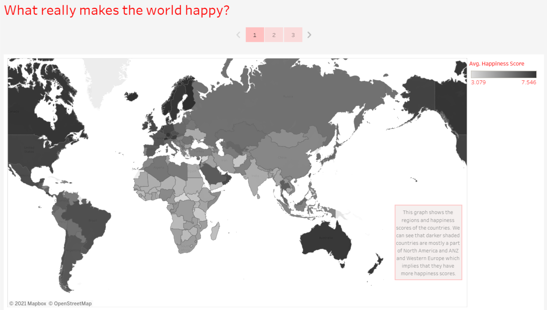

Slide 13
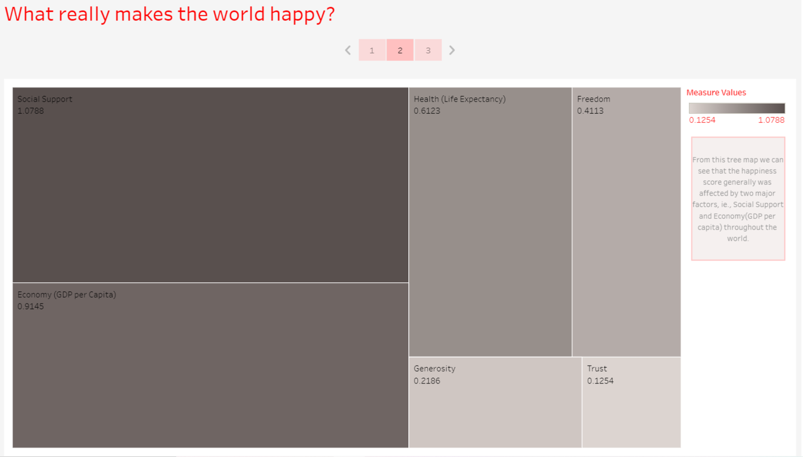

Slide 14
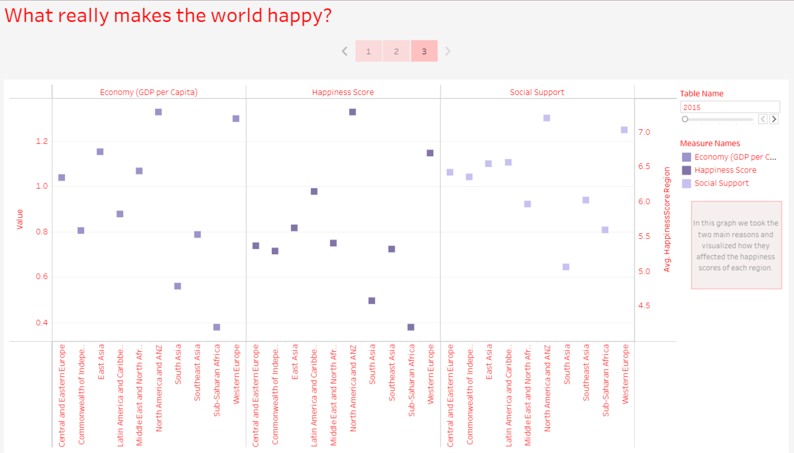

Slide 15
TABLEAU OUTPUT (Q1)
Which countries are better positioned in each of the aspects?

Slide 16
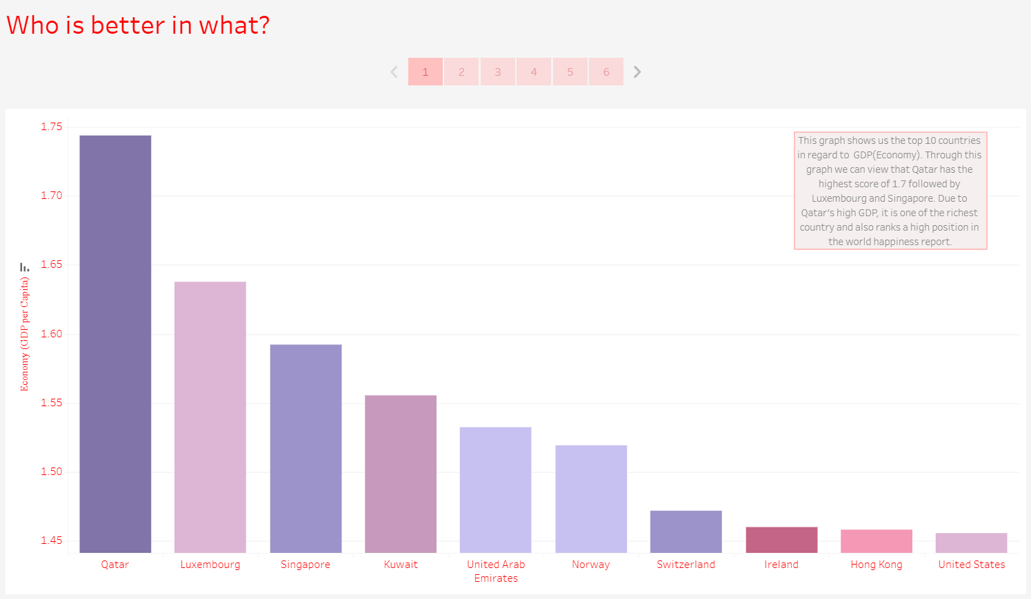

Slide 17
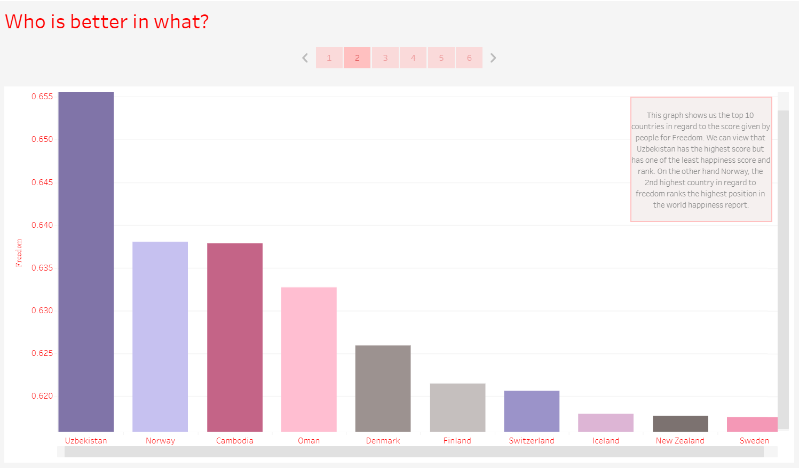

Slide 18
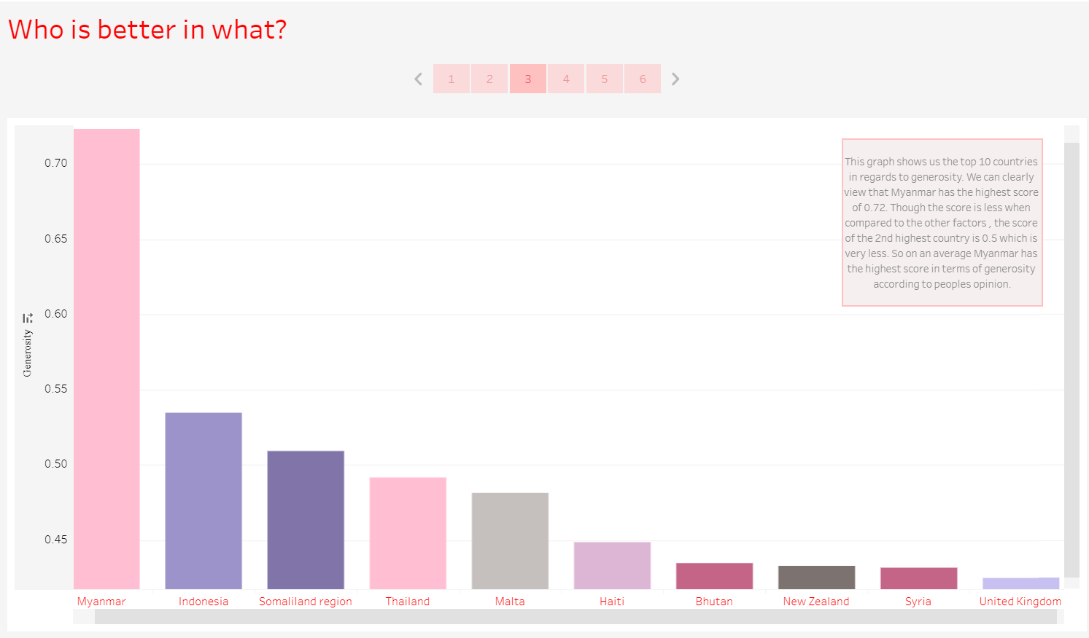

Slide 19
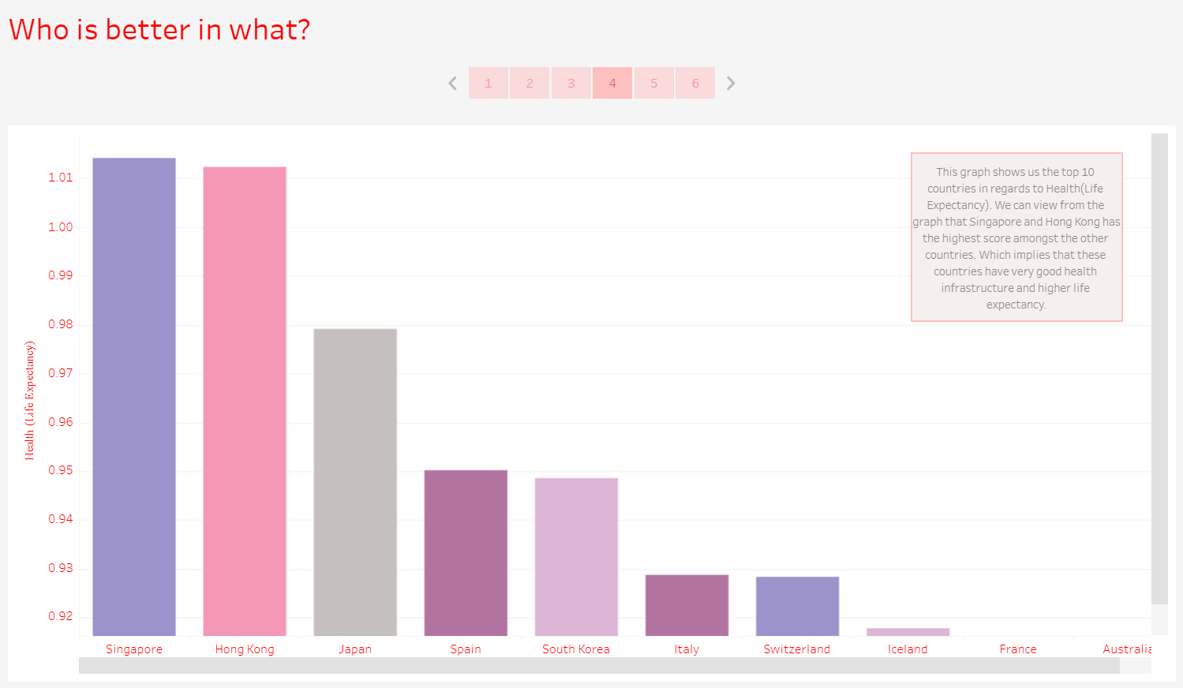

Slide 20
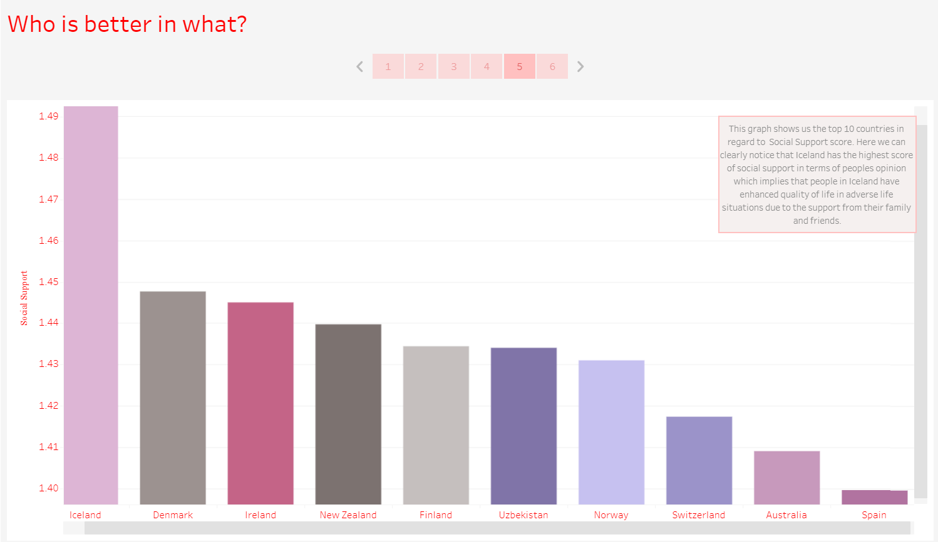

Slide 21
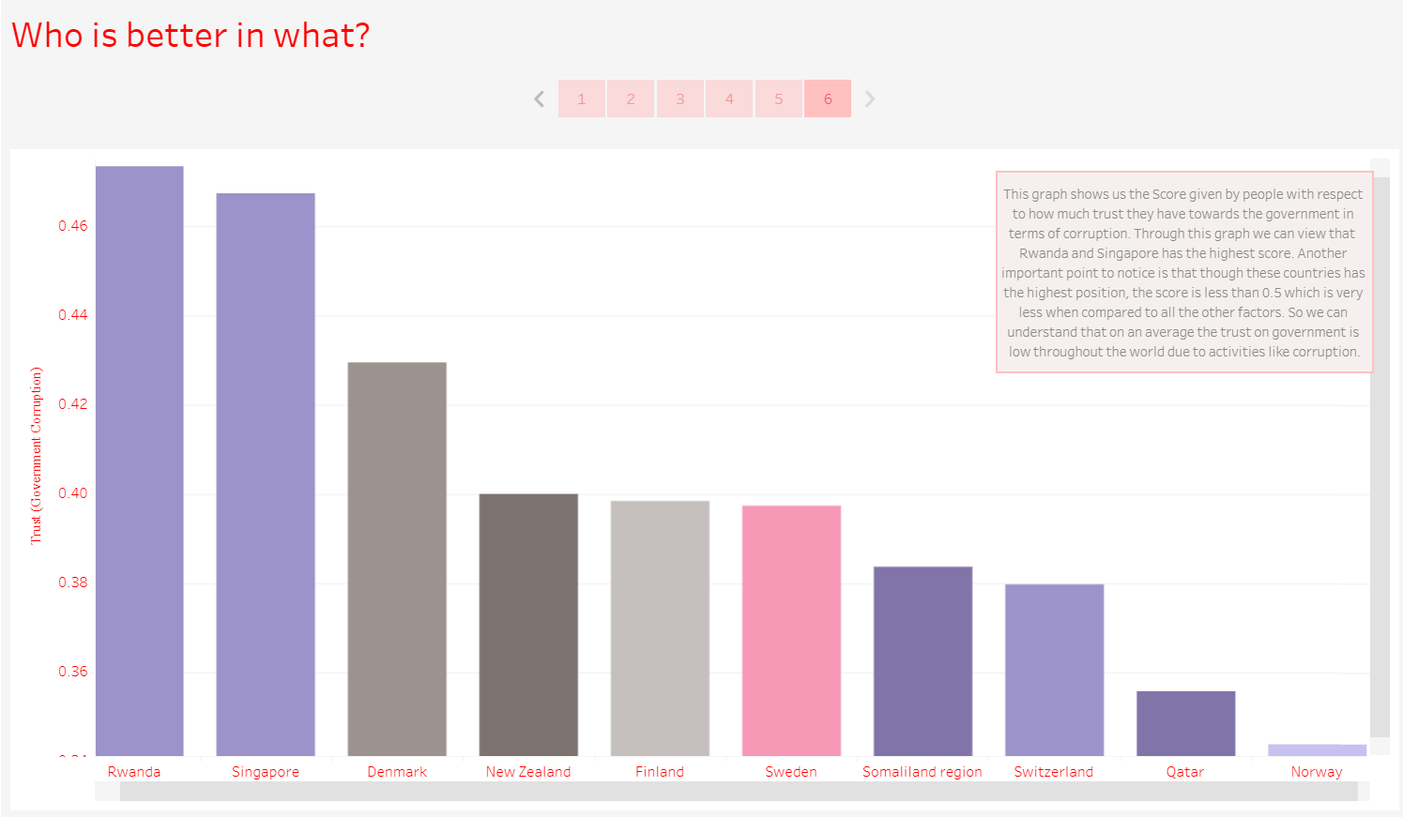

Slide 22
TABLEAU OUTPUT (Q2)
Finding the reason why happiness rank changed over the years in different regions?

Slide 23
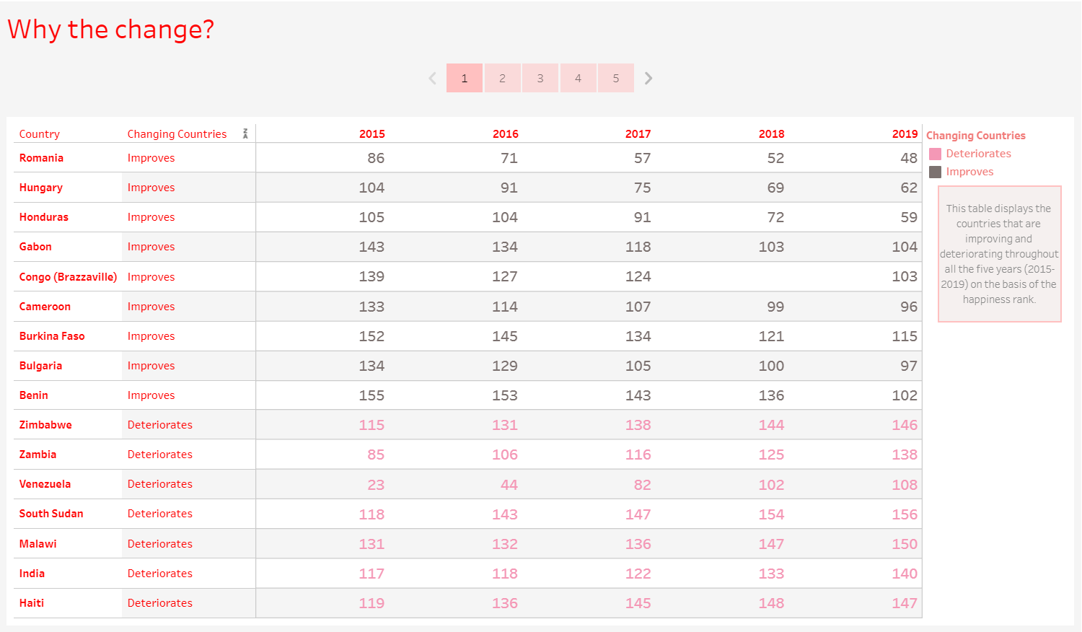

Slide 24
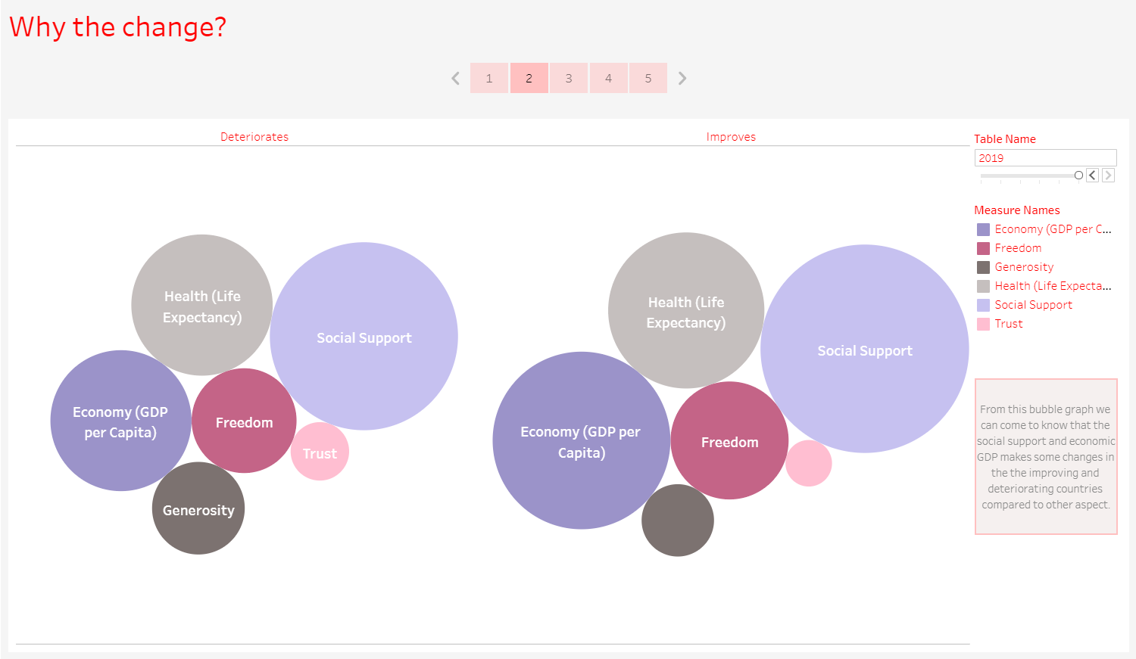

Slide 25
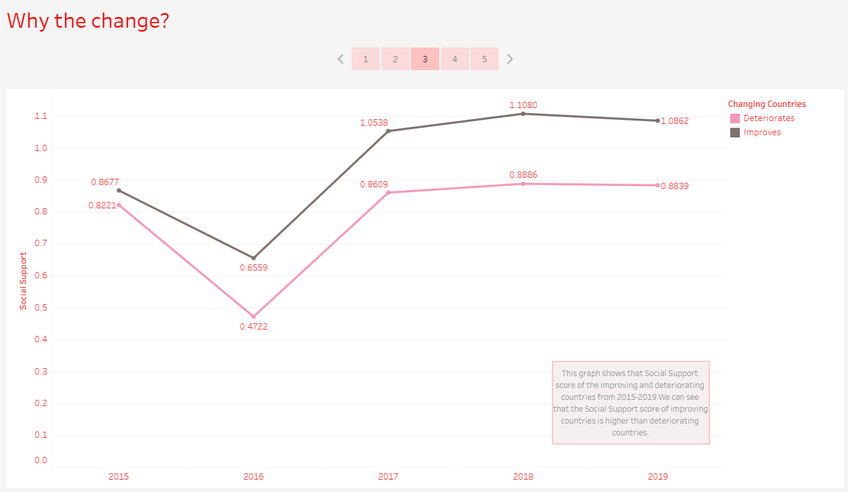

Slide 26
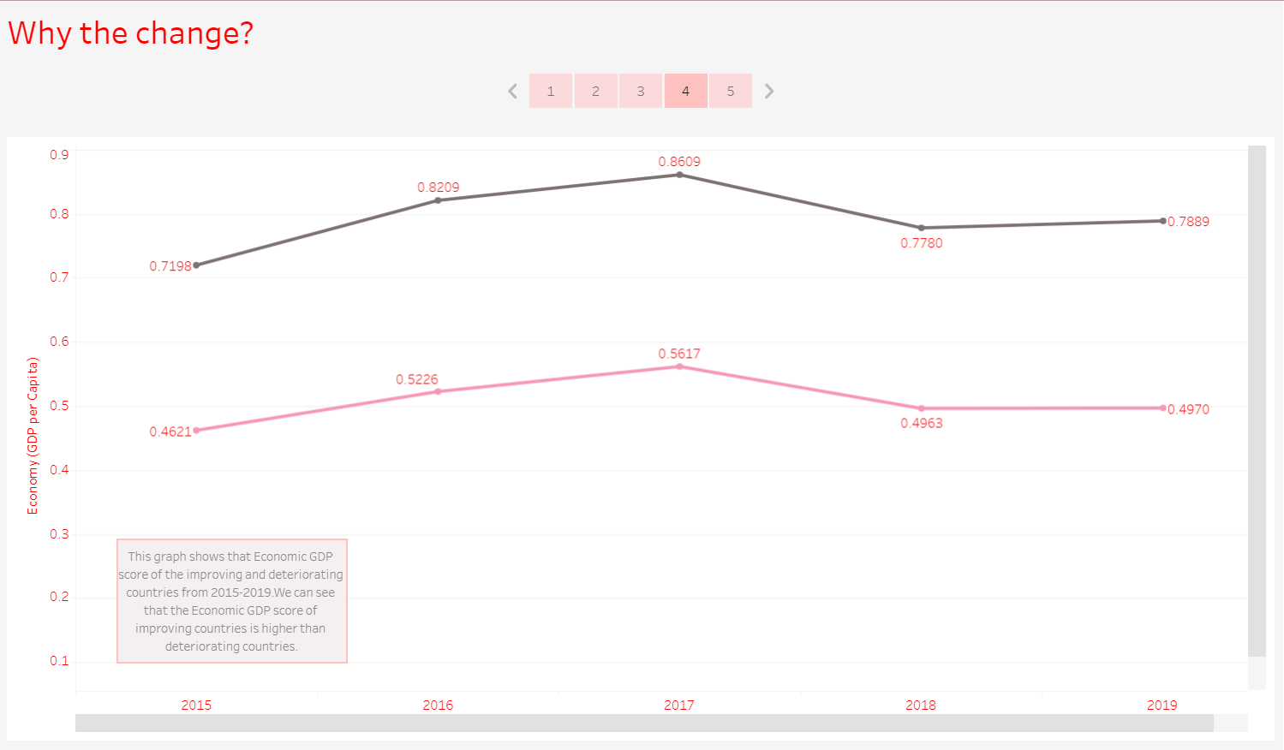

Slide 27
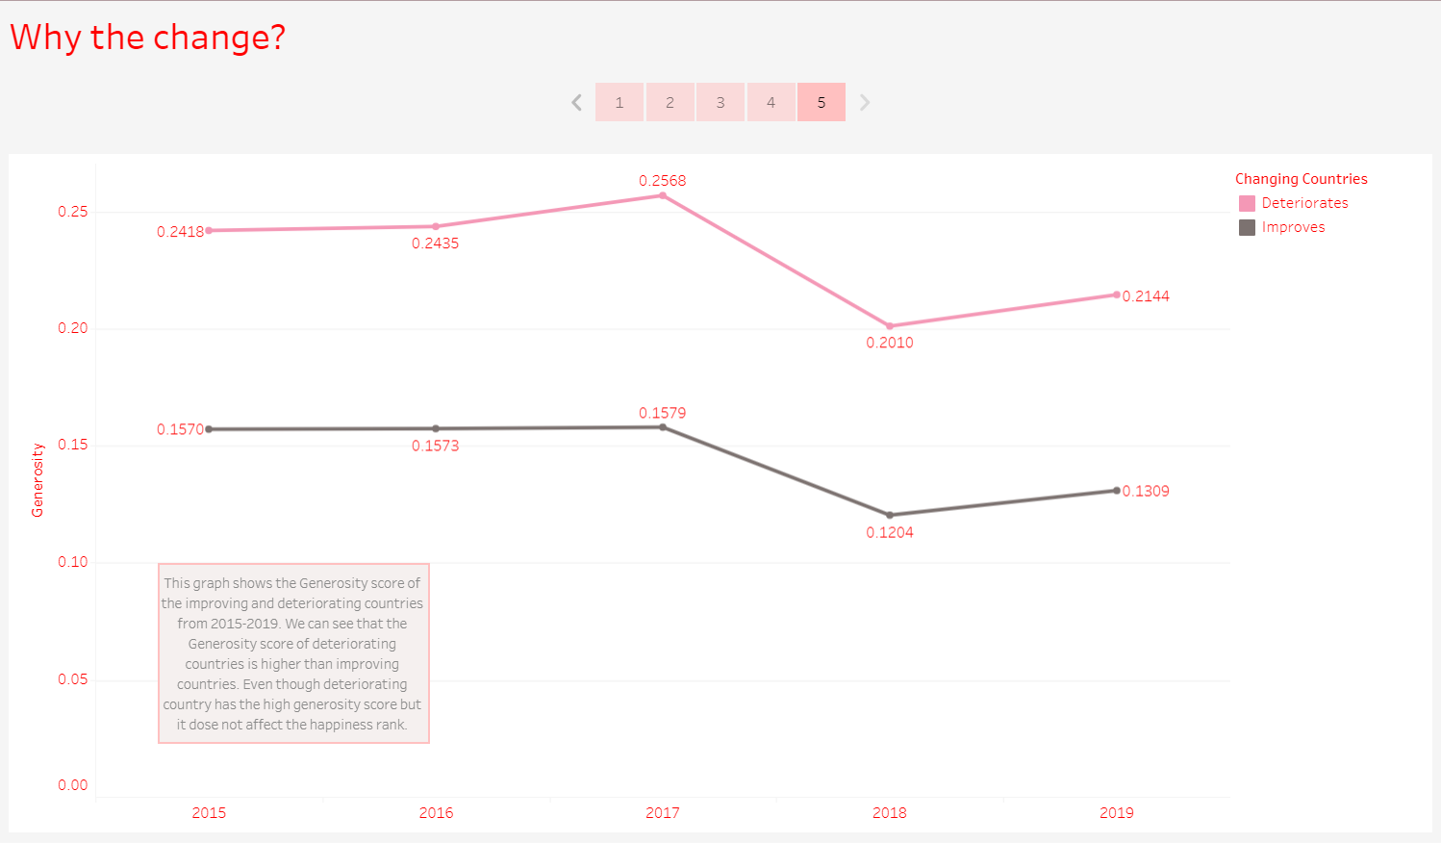

Slide 28
TABLEAU OUTPUT (Q3)
In what ways, Generosity and Health play a role in impacting the world happiness score?

Slide 29
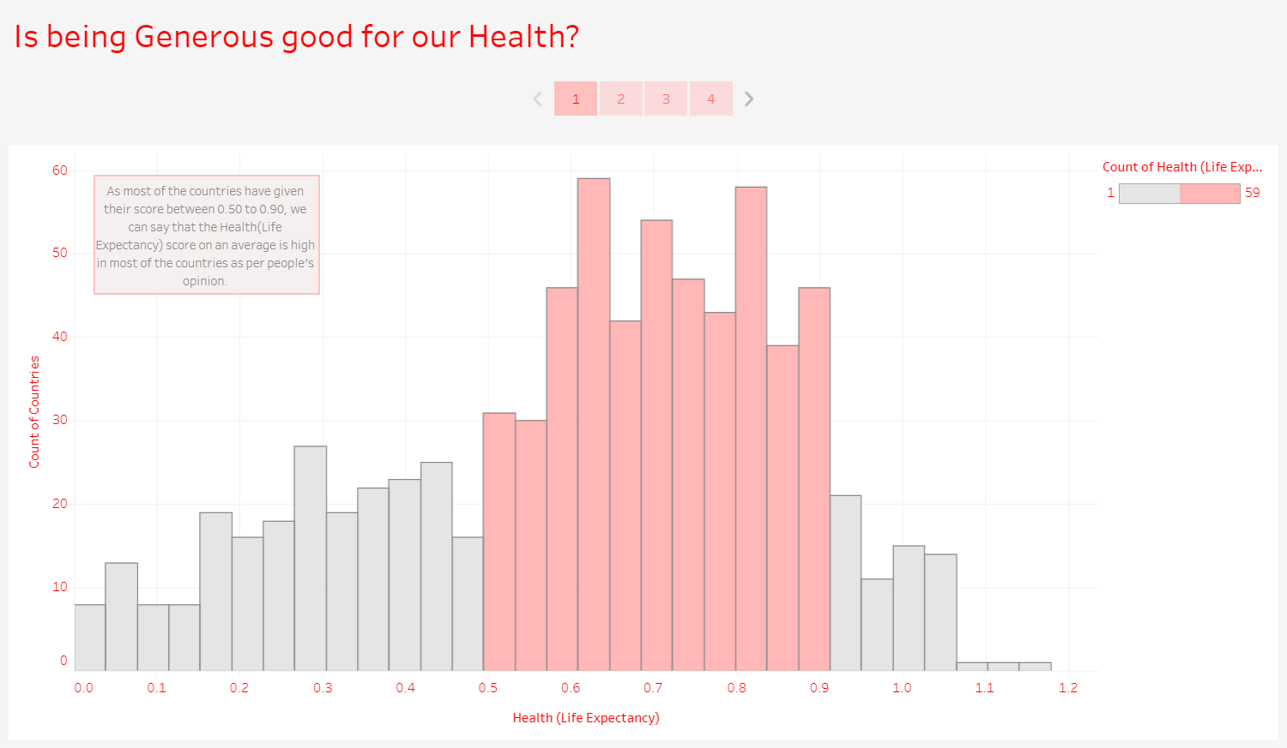

Slide 30
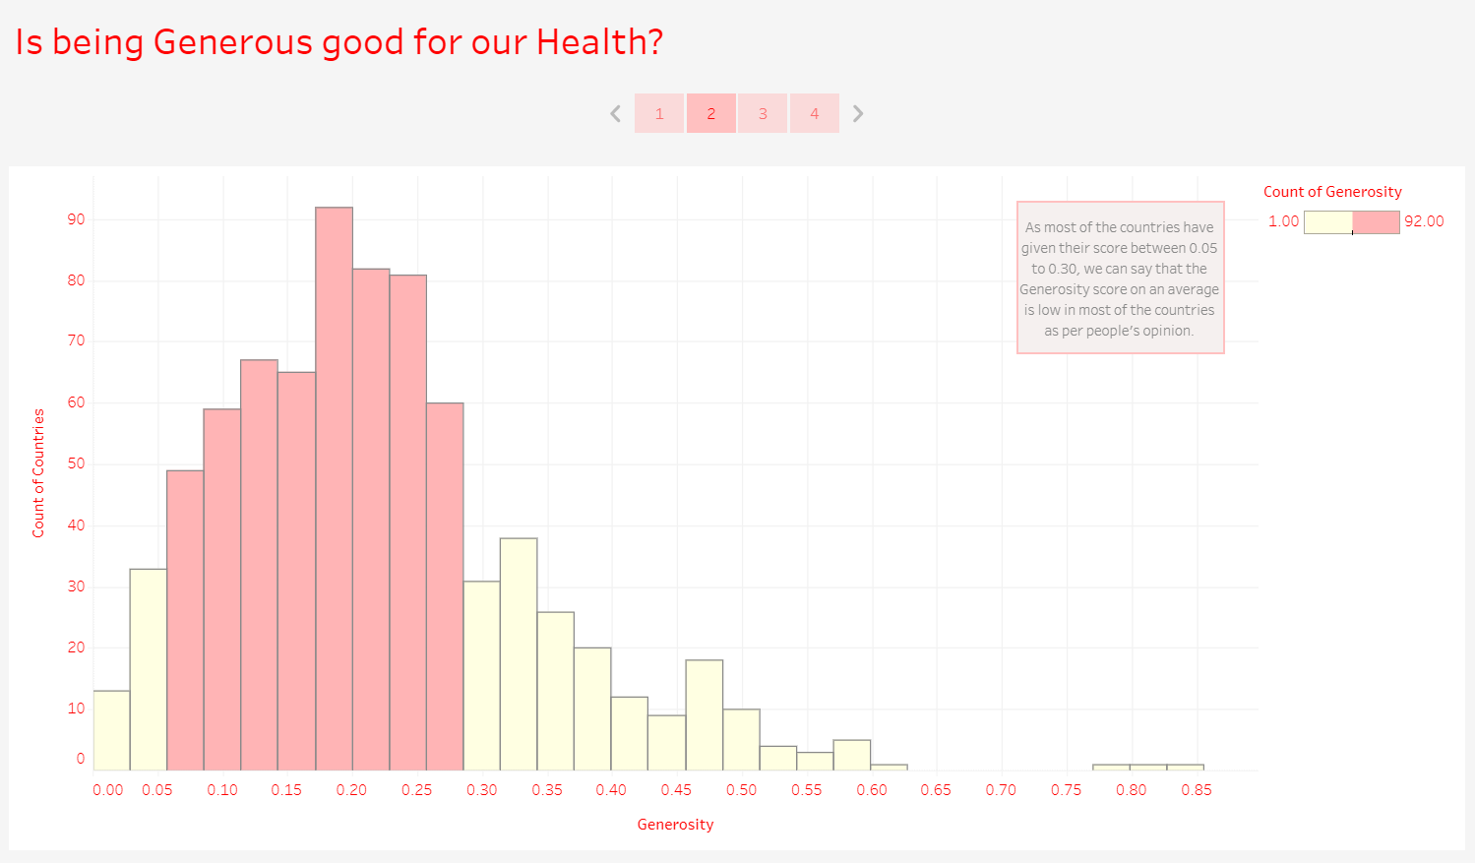

Slide 31
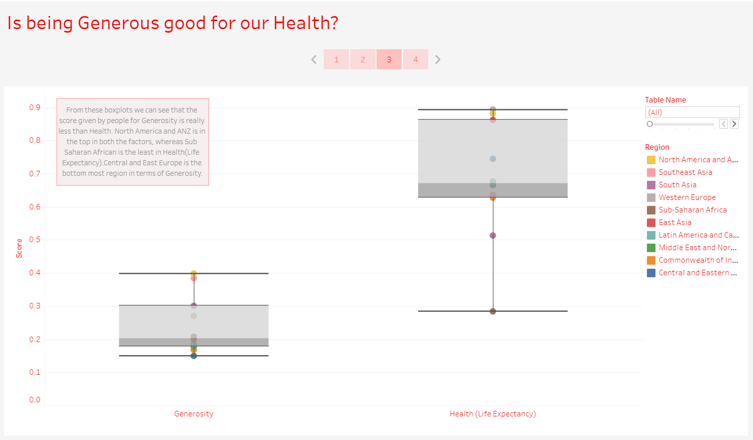

Slide 32
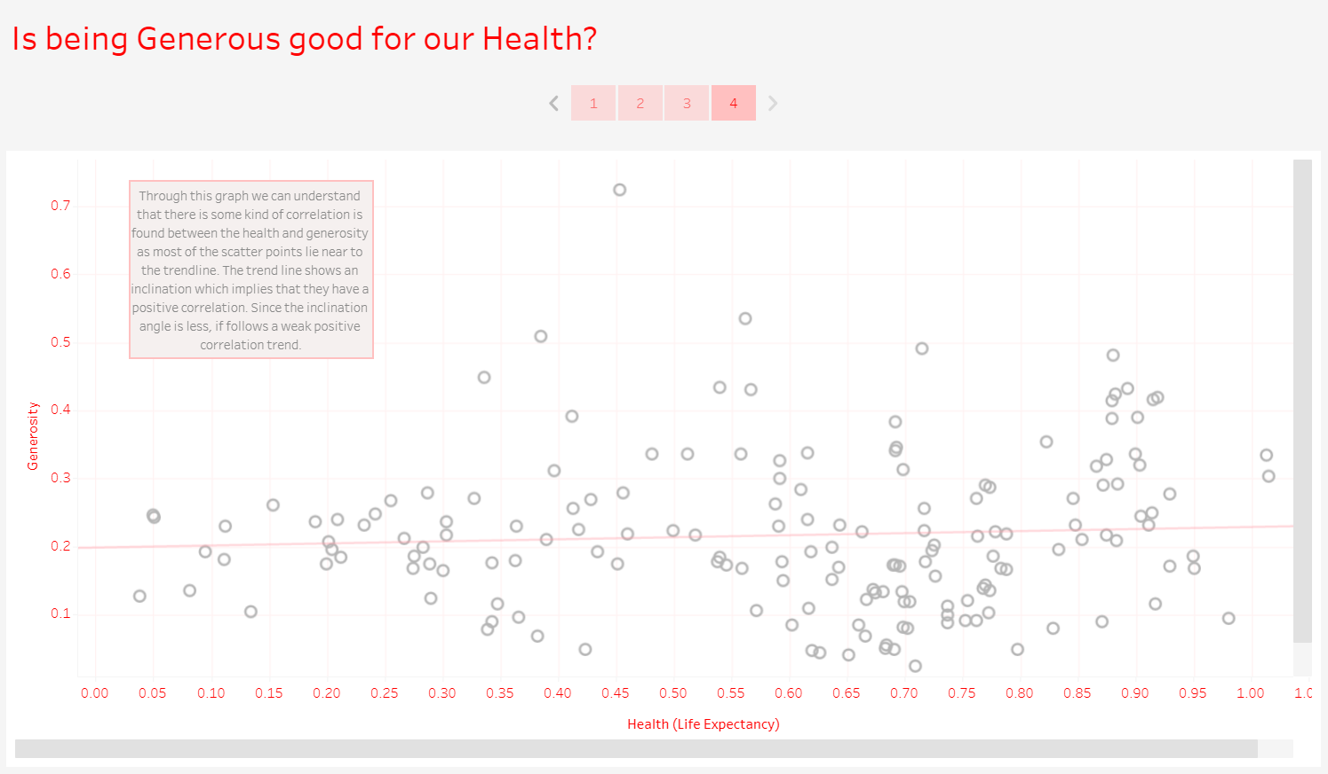

Slide 33
TABLEAU OUTPUT (Q4)
Does a country's GDP affect the happiness rate?

Slide 34
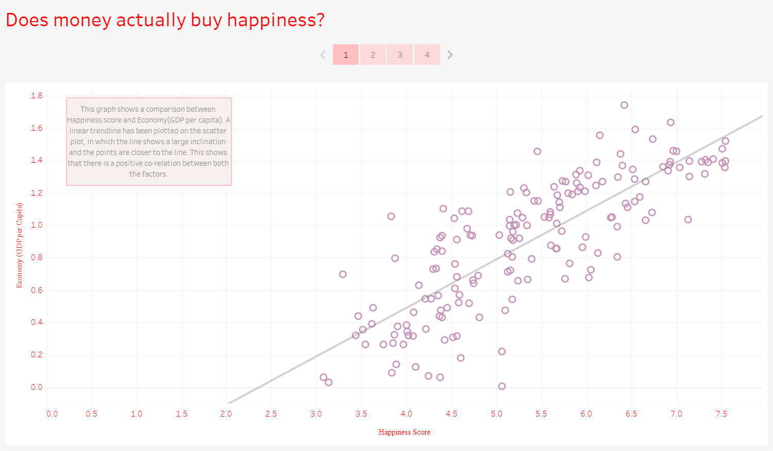

Slide 35
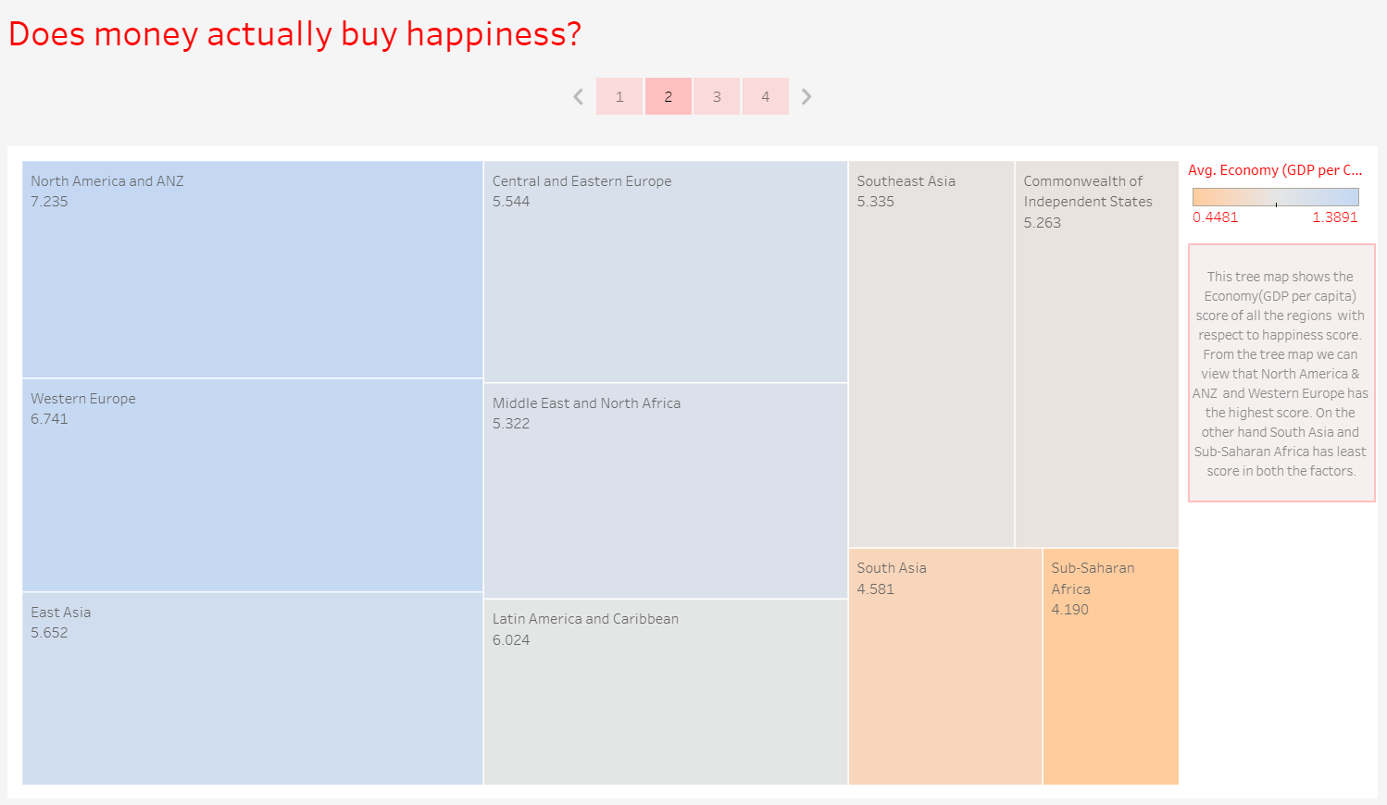

Slide 36
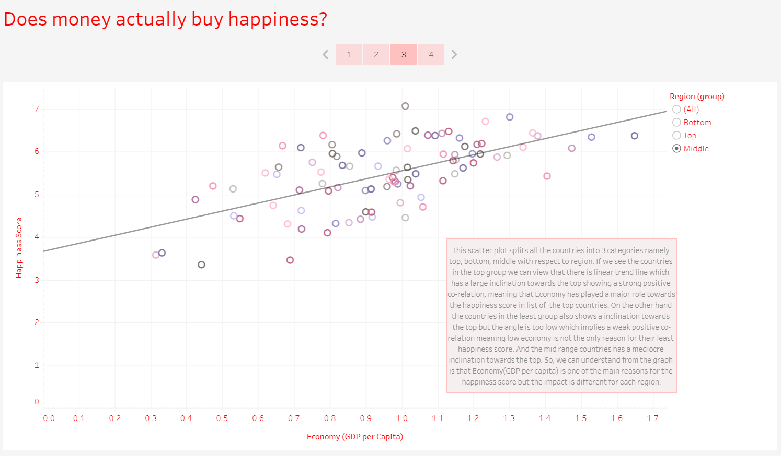

Slide 37
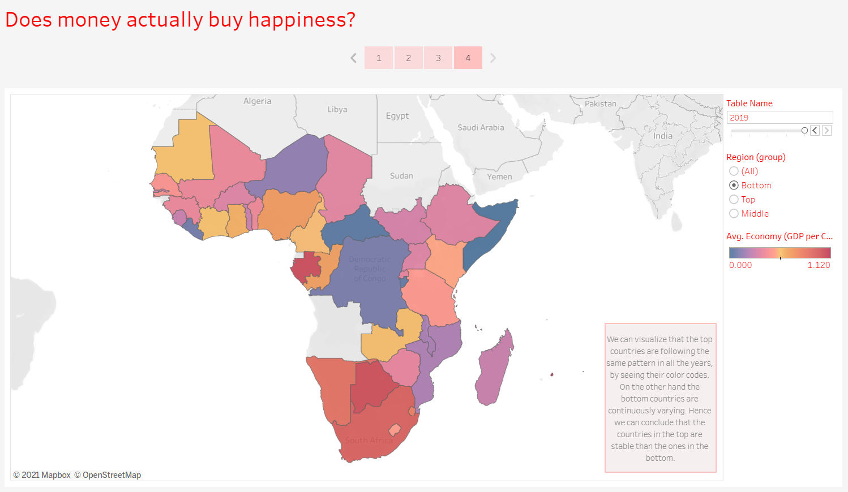

Slide 38
TABLEAU OUTPUT (Q5)
What is the trend followed by India’s happiness score in the past 5 years?

Slide 39
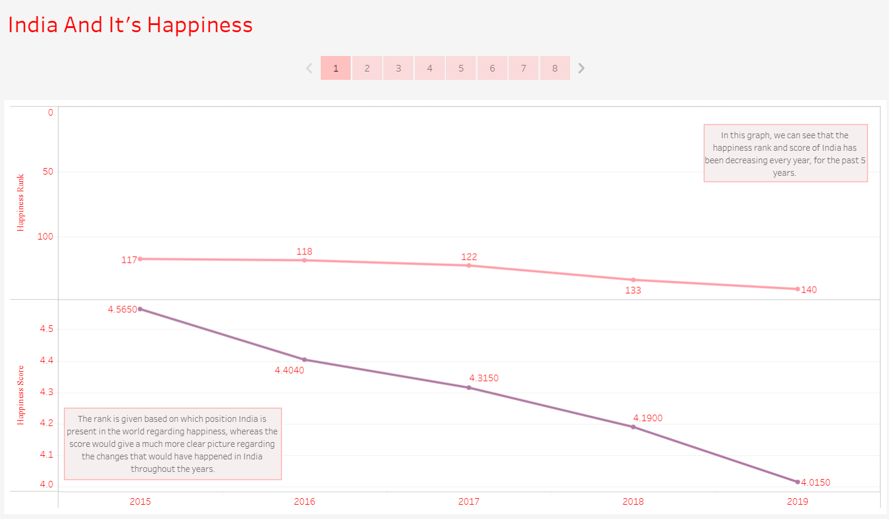

Slide 40
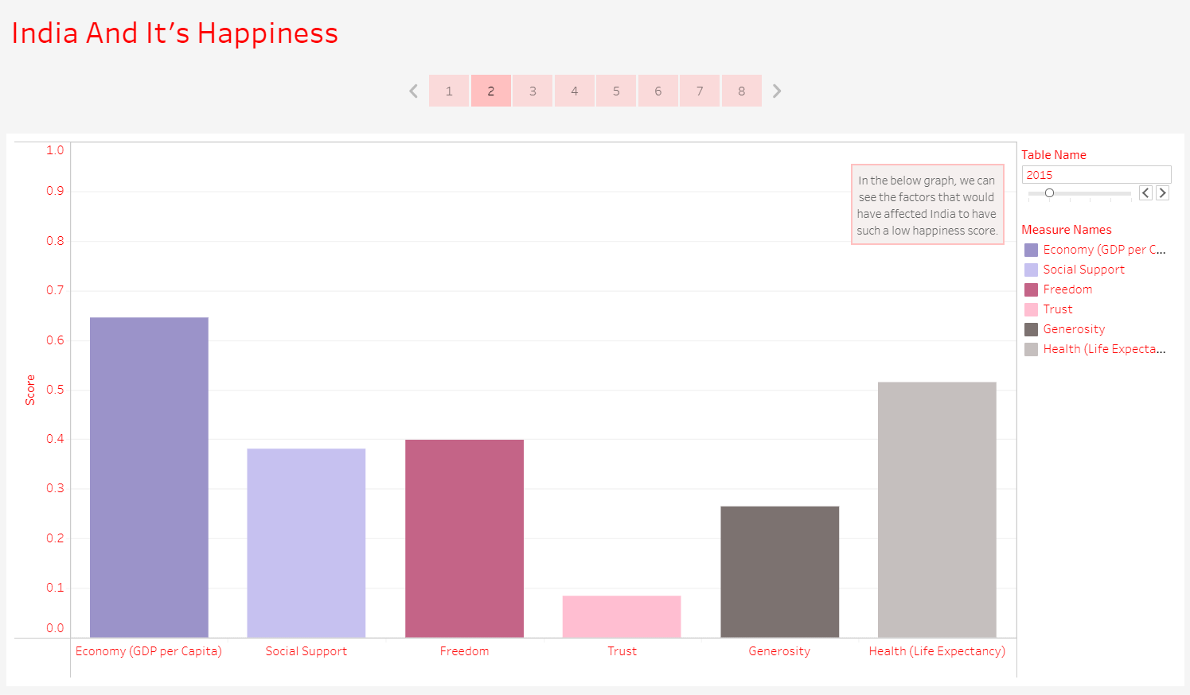

Slide 41
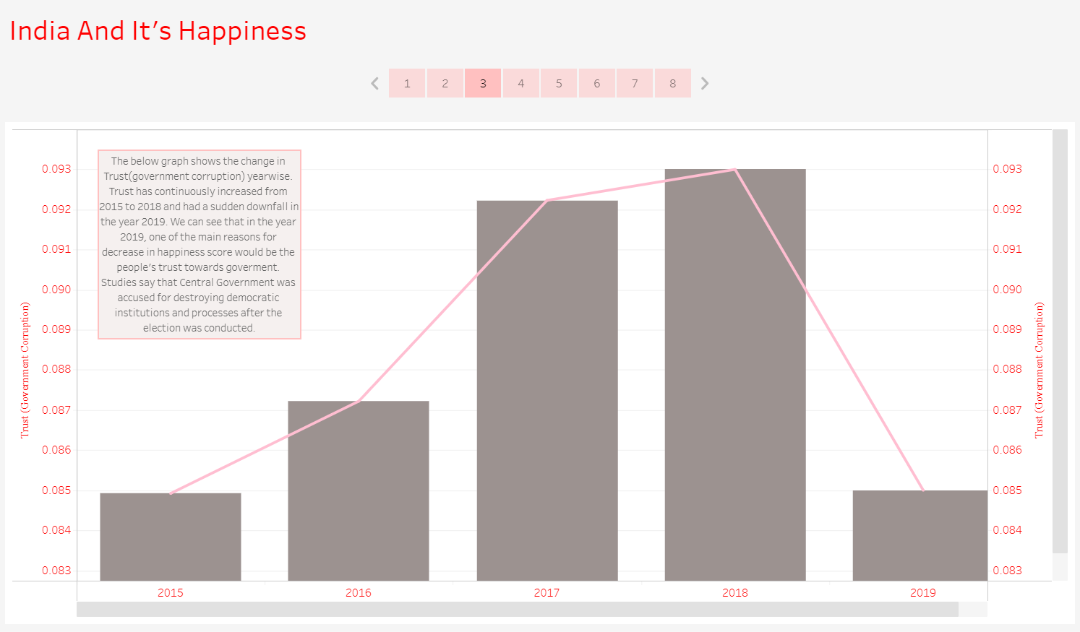

Slide 42
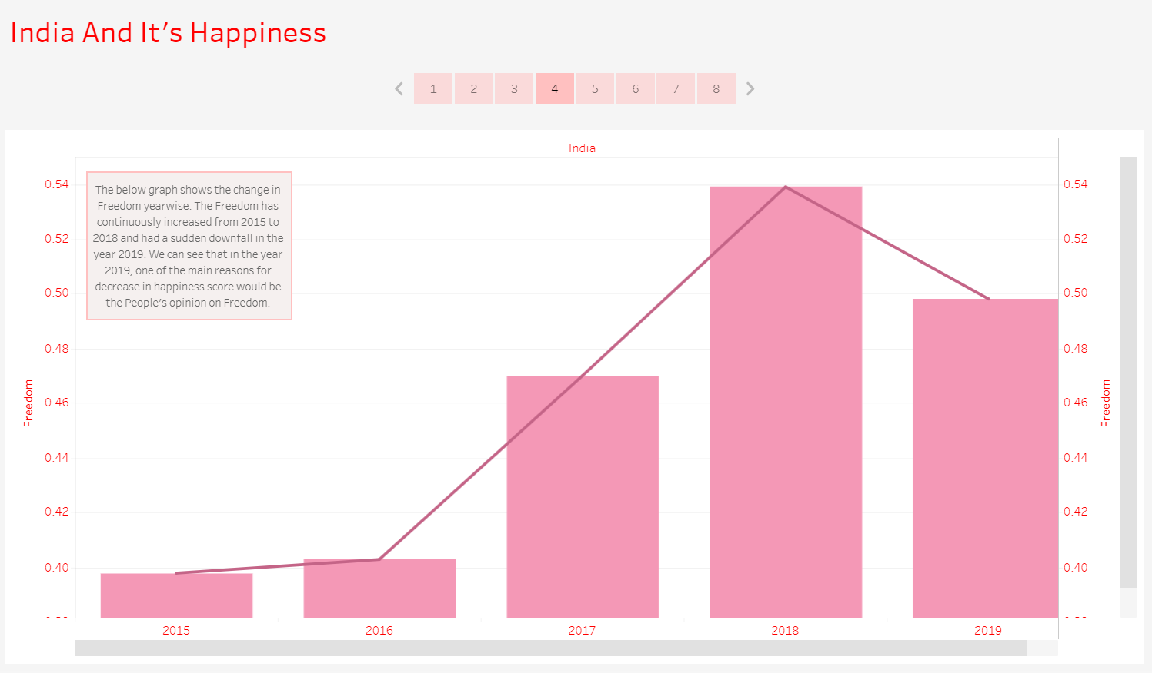

Slide 43
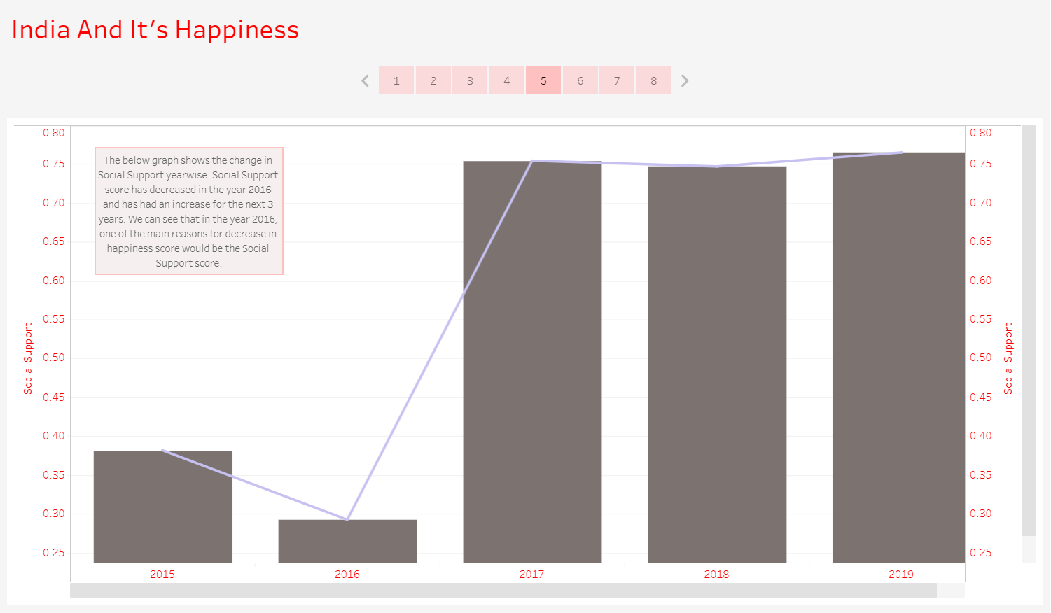

Slide 44
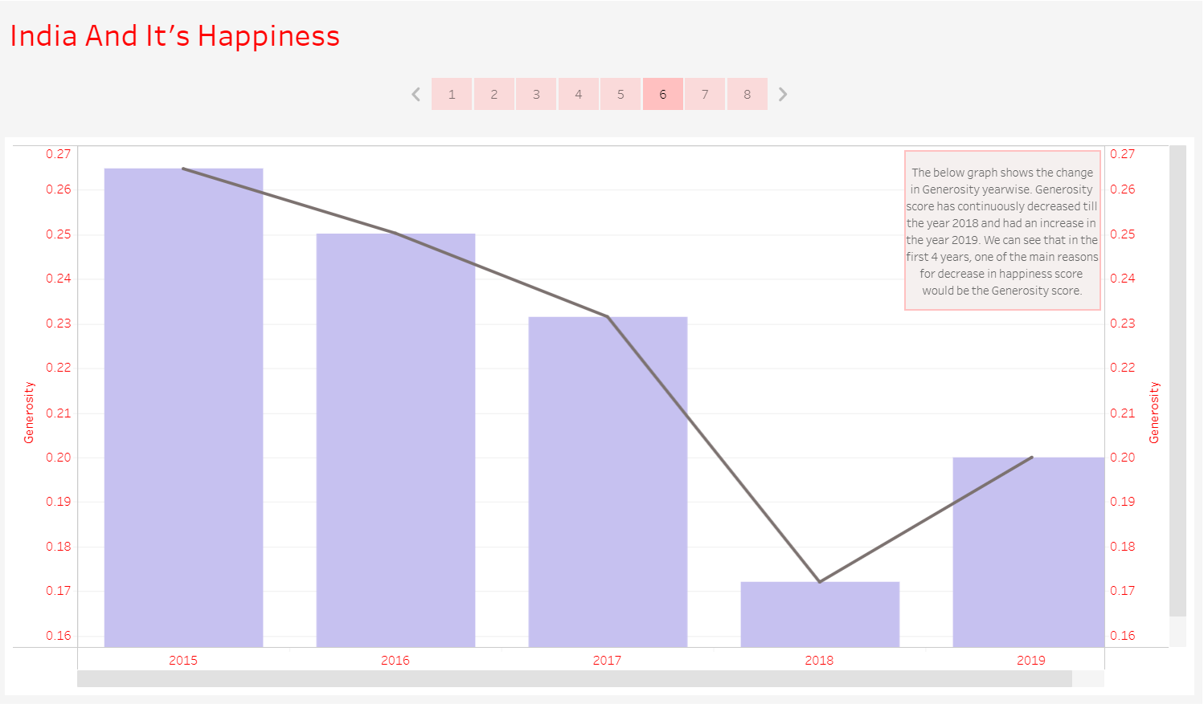

Slide 45
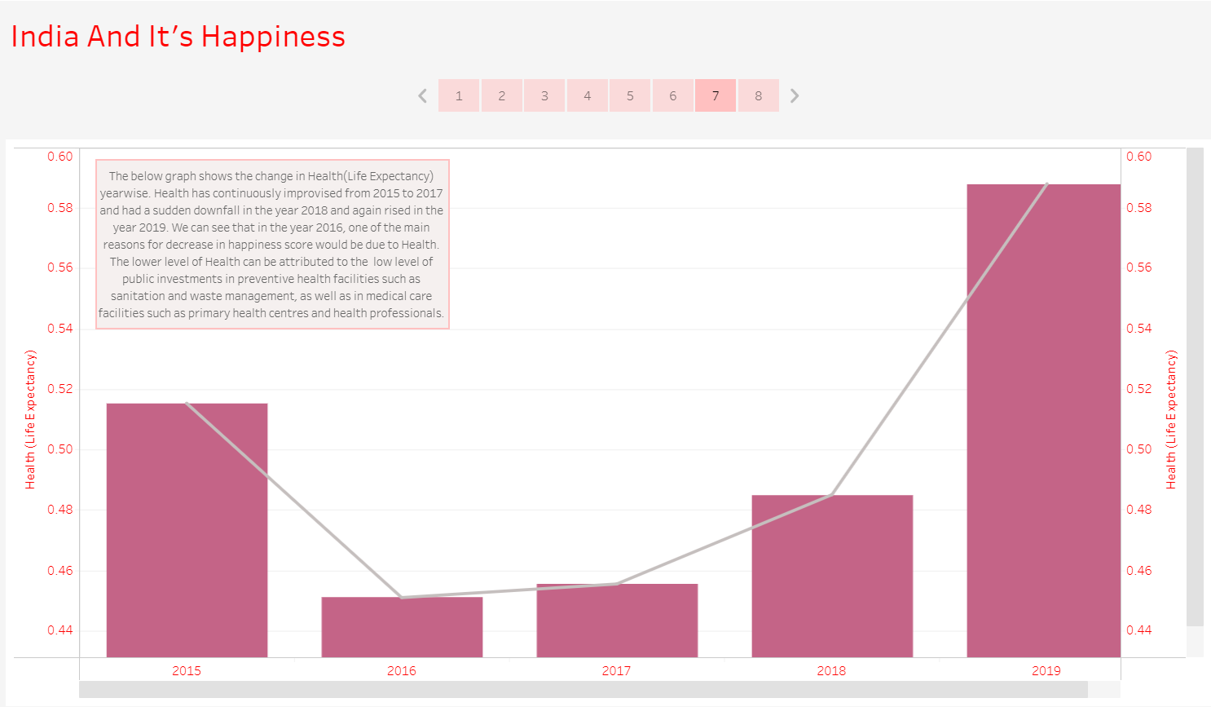

Slide 46
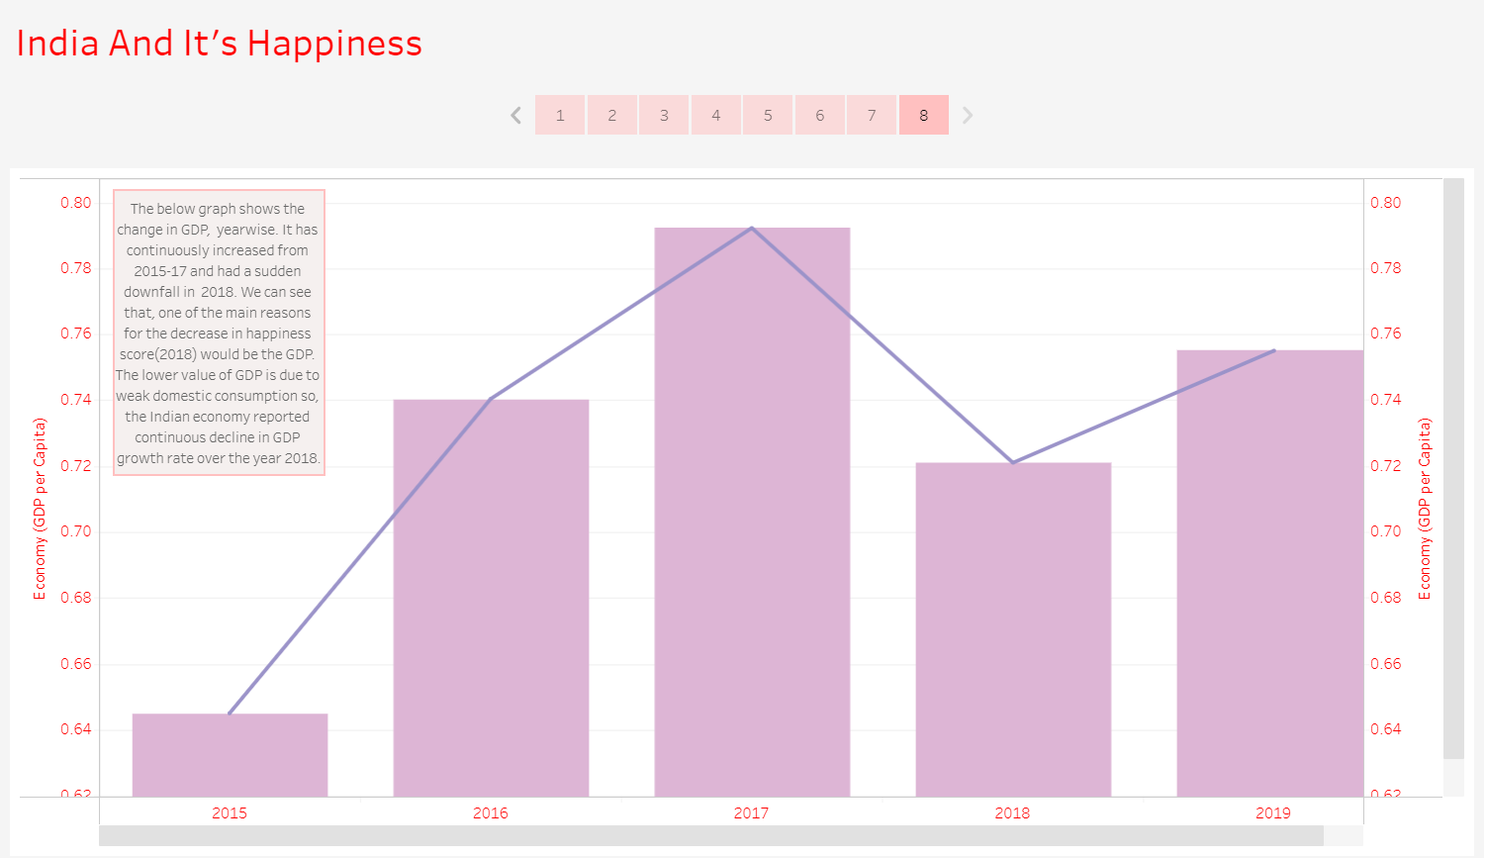

Slide 47
TABLEAU OUTPUT (Q6)
Which country had more trust in the government with respect to freedom?

Slide 48
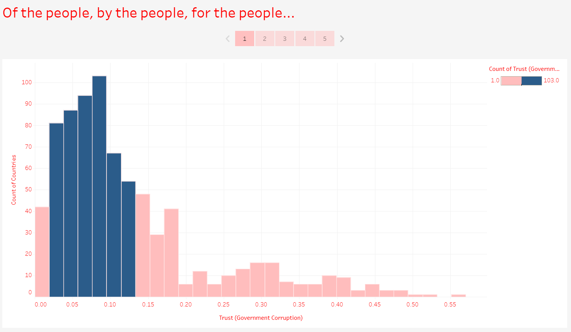

Slide 49
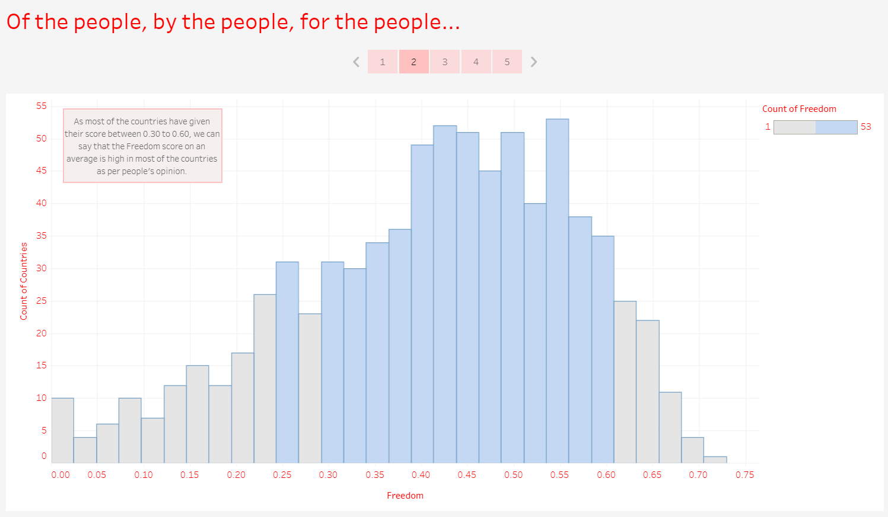

Slide 50
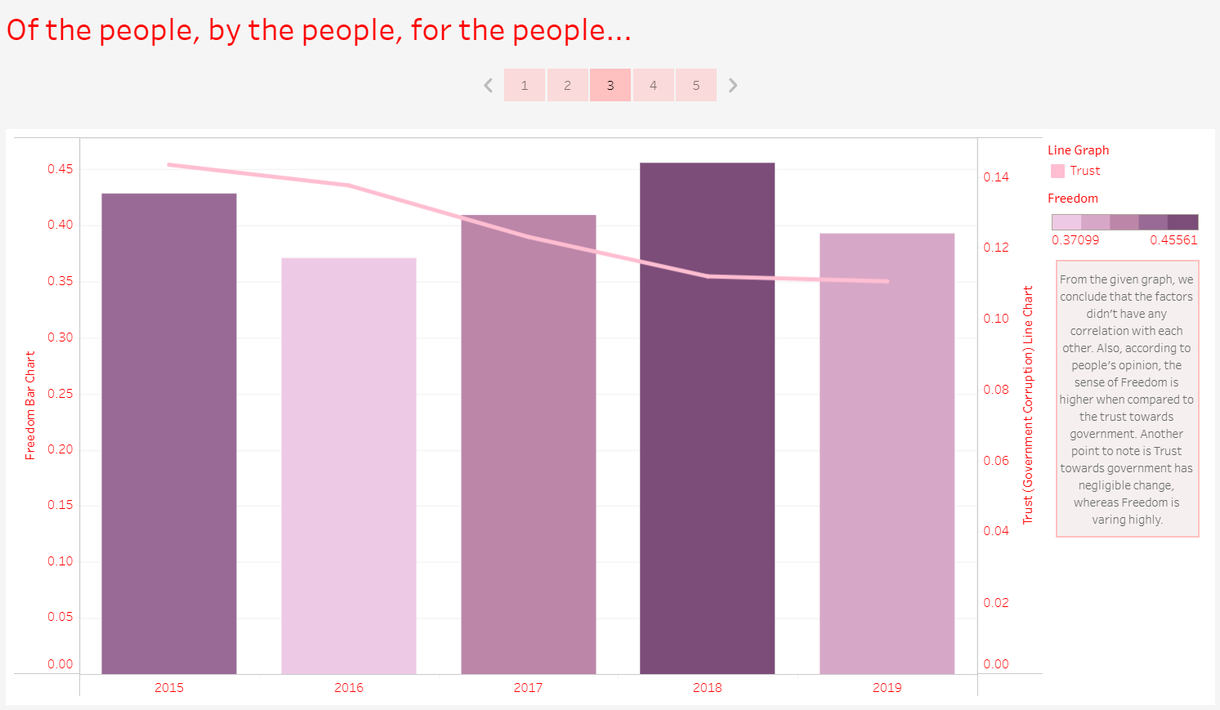

Slide 51
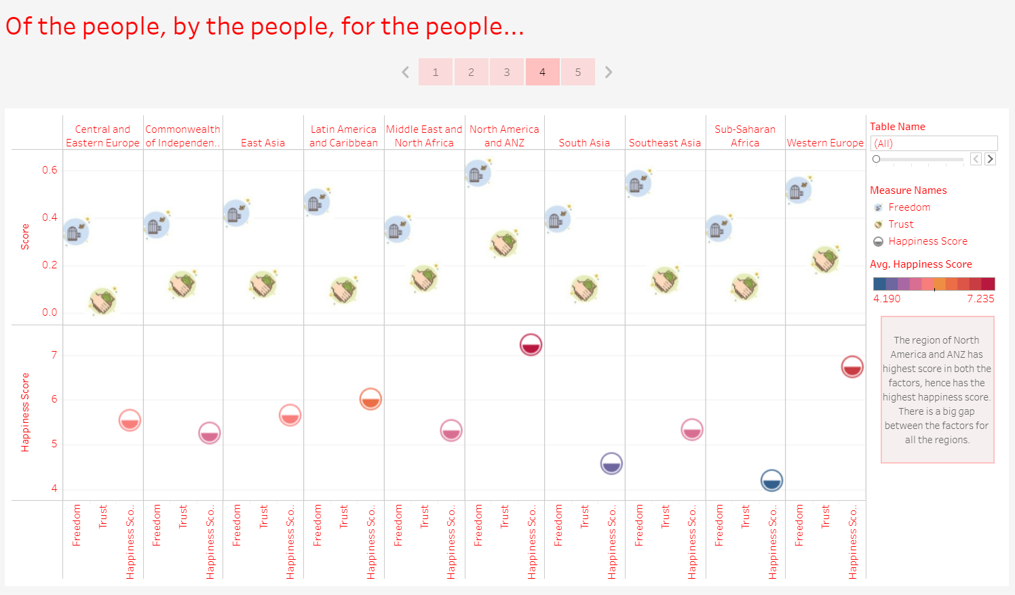

Slide 52
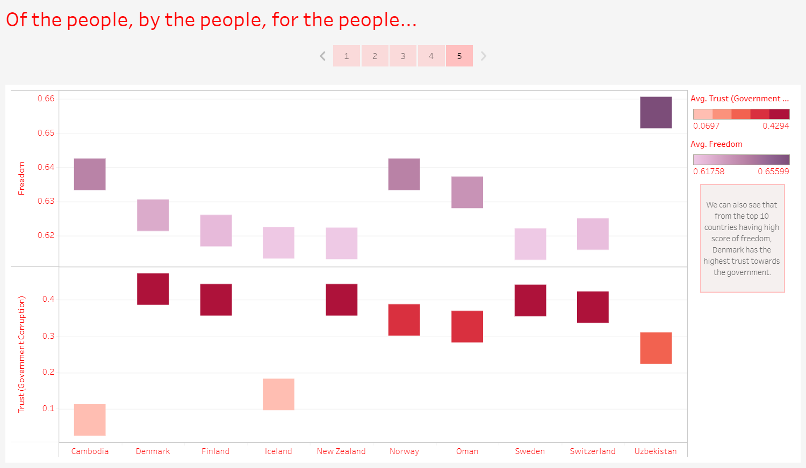

Slide 53
TABLEAU OUTPUT (Q7)
An analysis to find which are the factors causing fewer happiness scores in a few regions and prediction on how it would be if each factor is improved.

Slide 54
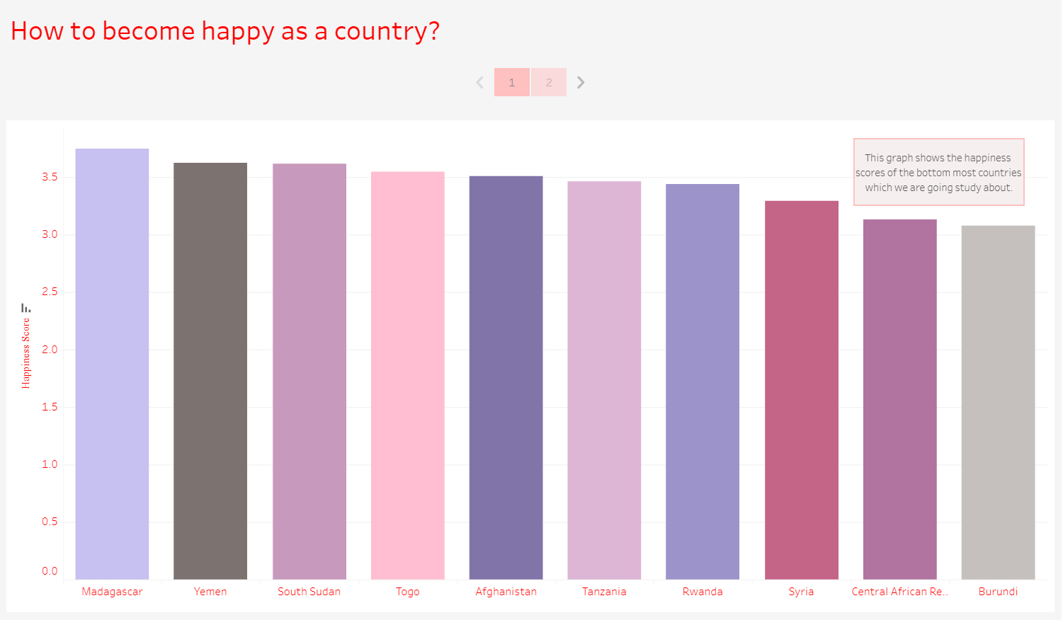

Slide 55
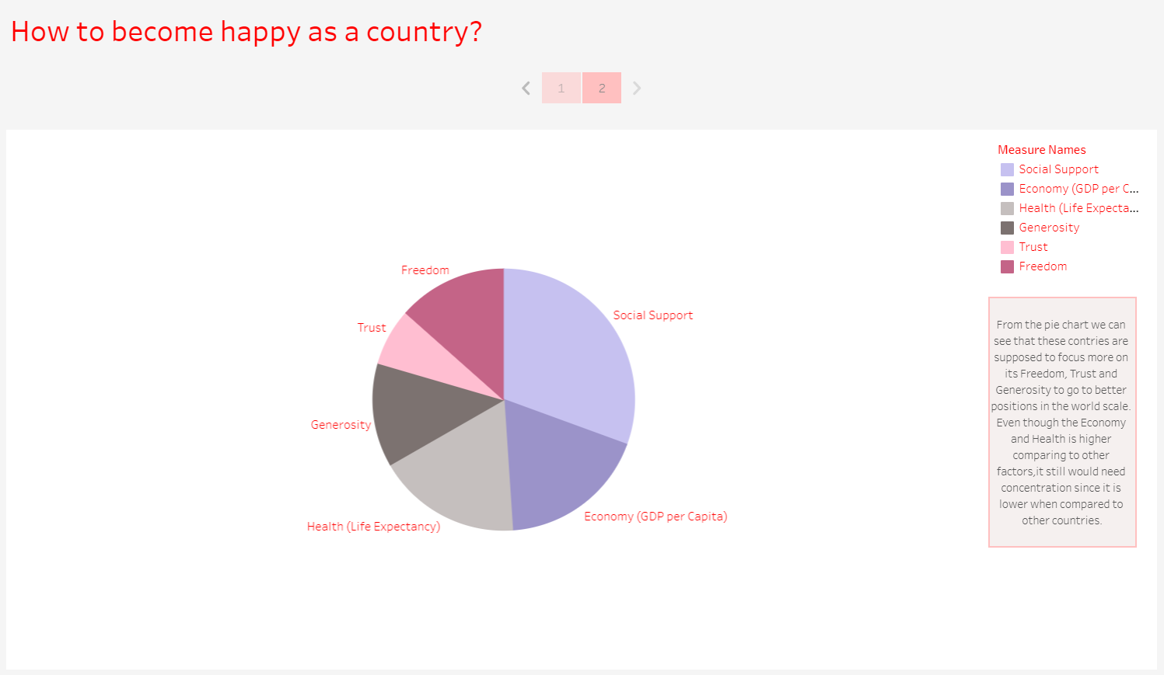

Slide 56
WORKFLOW DIAGRAM OF WEBSITE
01
Home Page
It is the opening page of the website
It has the links to the other two pages
It displays the general information about the dataset chosen
02
About Dataset
It has the links to the other two pages
It displays information about what the report depends on and clearly explains how the values are calculated
03
Analysis
It has the links to the other two pages
It displays the questions that has been answered during the analysis
Each question is a link to the explanation page
04
Questions Page
It has the links to the other three pages
It displays the question and the tableau screen in the form of a story
Each Page has the Link of Dataset and the GitHub repository containing website and Tableau in the Footer

Slide 57
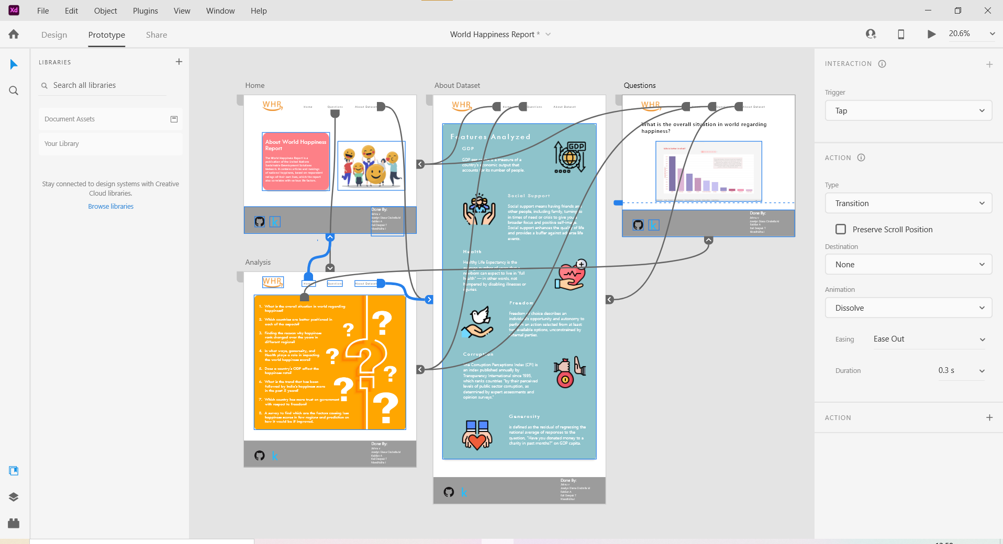
WEBSITE UI DESIGN (Using ADOBE XD)

Slide 58
TIMELINE
Date | Duration | Work Completed
1/6/2021 - 5/6/2021 | 5 days | Learnt how to handle a sample dataset
6/6/2021 - 9/6/2021 | 4 days | Finished Learning Tableau Software
10/6/2021 - 11/6/2021 | 2 days | Finished Learning MySQL Software
12/6/2021 | 1 day | Choosing topic for DA project
13/6/2021 - 14/6/2021 | 2 days | Forming Questions for Analysis
15/6/2021 - 17/6/2021 | 3 days | Cleansing of Dataset, Importing to MySQL and Connection of MySQL with Tableau
18/6/2021 - 1/7/2021 | 14 days | Analysis of All the questions and Creation of Storyboards
2/7/2021 - 5/7/2021 | 4 days | Finished learning Angular 2.0 and React
6/7/2021 - 7/7/2021 | 2 days | Learning and using concept of Prediction in Tableau for Last Question and Designed the website

Slide 59
CONCLUSIONS
From the overall analysis of the World Happiness Report, we could come to a conclusion that, the level of happiness is not the same throughout the world. It varies based on various factors in different ways in different countries. And on the basis of analysis we made ,we found that Economy(GDP per capita), Social Support are two of the main factors contributing to happiness.

Slide 60
REFERENCES
https://www.youtube.com/watch?v=aHaOIvR00So - for learning Tableau
https://www.youtube.com/watch?app=desktop&v=7S_tz1z_5bA&ab_channel=ProgrammingwithMosh - for learning MySQL
https://www.kaggle.com/mathurinache/world-happiness-report?select=2015.csv - for Collecting Dataset
https://plnkr.co/edit/ZSfSja?p=info&preview - for integration of Tableau into Website
https://www.datacamp.com/community/tutorials/git-push-pull - for using github Repository
https://m.youtube.com/watch?v=bJKejcQJqHE - for referring related to Angular 2.0
https://m.youtube.com/watch?v=k1RI5locZE4 - for learning AWS
https://m.youtube.com/watch?v=CI2kX2EFhWc - for learning React JS

Slide 61
Thank you!

